Slide 1

Oracle 12c: SQL
Chapter 9
Joining Data from Multiple Tables
©2016. Cengage Learning. All rights reserved.

Slide 2
Objectives
Identify a Cartesian join
Create an equality join using the WHERE clause
Create an equality join using the JOIN keyword
Create a non-equality join using the WHERE clause
Create a non-equality join using the JOIN…ON approach
©2016. Cengage Learning. All rights reserved.

Slide 3
Objectives (continued)
Create a self-join using the WHERE clause
Create a self-join using the JOIN keyword
Distinguish an inner join from an outer join
Create an outer join using the WHERE clause
Create an outer join using the OUTER keyword
Use set operators to combine the results of multiple queries
©2016. Cengage Learning. All rights reserved.

Slide 4
Purpose of Joins
Joins are used to link tables and reconstruct data in a relational database
Joins can be created through:
  Conditions in a WHERE clause
  Use of JOIN keywords in FROM clause
©2016. Cengage Learning. All rights reserved.

Slide 5
SQL Joins
All joins can be classified as:
  Inner Joins
    Merge rows from two tables and returns the rows that have common values in common columns
    Also called equality join, equijoin, or natural join
  Outer Joins
    Merge rows from two tables and returns the rows that have common values in common columns or have no matching values

Slide 6
SQL Joins: Examples
Joins using WHERE:
  SELECT customer.c_id, invoice.inv_number
  FROM customer, invoice
  WHERE customer.c_id = invoice.c_id;
Joins using JOIN keyword:
  SELECT customer.c_id, invoice.inv_number
  FROM customer JOIN invoice USING (c_id);
Need to mention the table name. If we don’t mention the table it will give all the combination.
First one applied for all database. Second one is only for oracle.

Slide 7
Cartesian Joins
Created by omitting joining condition in the WHERE clause or through CROSS JOIN keywords in the FROM clause
Results in every possible row combination (m * n)
Often used for statistical procedures for data analysis
Sometimes a user intends to generate a Cartesian product, but usually this intention is the exception rather than the rule
  Often, it’s mistakenly produced when a user uses the join conditions incorrectly or omits them

Slide 8
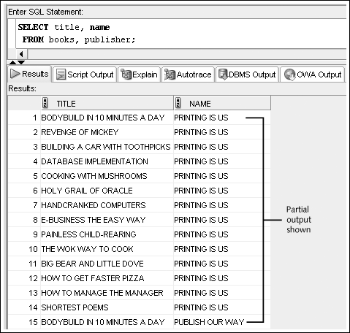
Cartesian Join Example:
Omitted Condition
©2016. Cengage Learning. All rights reserved.

Slide 9
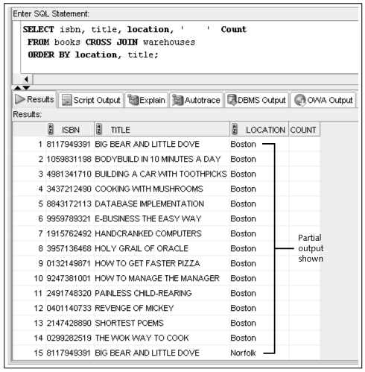
Cartesian Join Example:
CROSS JOIN Keywords
Only for Oracle
©2016. Cengage Learning. All rights reserved.

Slide 10
Equality Joins
Link rows through equivalent data that exists in both tables
Created by:
  Creating equivalency condition in the WHERE clause
  Using NATURAL JOIN, JOIN…USING, or JOIN…ON keywords in the FROM clause
©2016. Cengage Learning. All rights reserved.

Slide 11
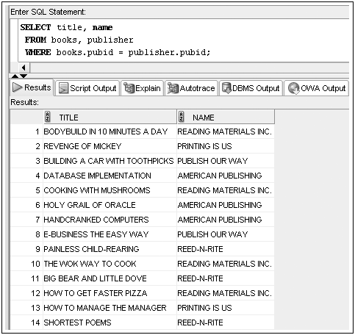
Equality Joins: WHERE Clause Example
©2016. Cengage Learning. All rights reserved.

Slide 12
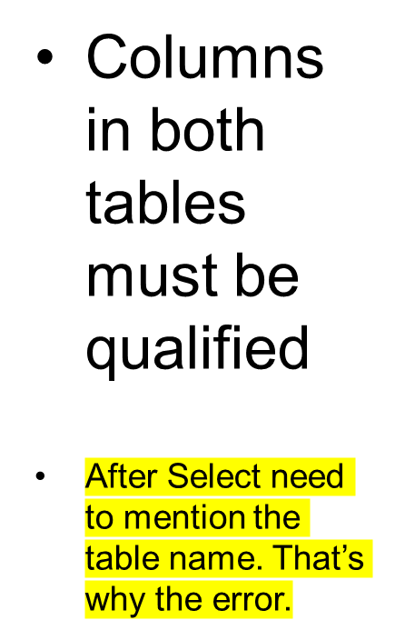
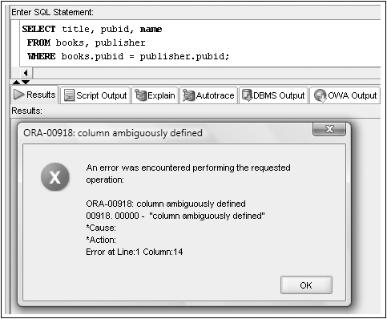
Qualifying Column Names
©2016. Cengage Learning. All rights reserved.

Slide 13
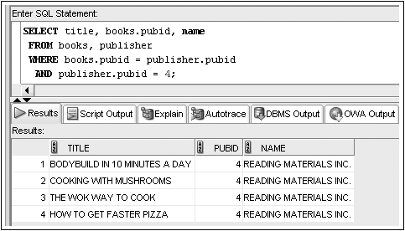
WHERE Clause Supports Join and Other Conditions
©2016. Cengage Learning. All rights reserved.

Slide 14
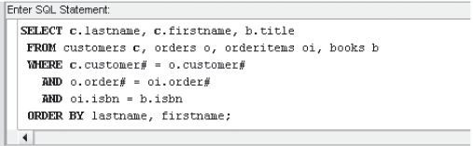
Joining More Than Two Tables
Joining four tables requires three join conditions
©2016. Cengage Learning. All rights reserved.

Slide 15

Equality Joins: NATURAL JOIN
©2016. Cengage Learning. All rights reserved.

Slide 16
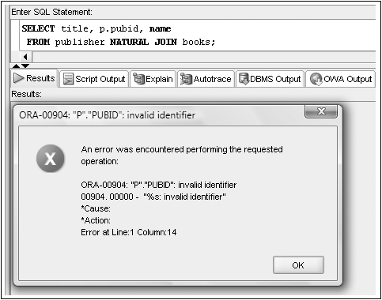
No Qualifiers with a NATURAL JOIN
©2016. Cengage Learning. All rights reserved.

Slide 17

Equality Joins: JOIN…USING
©2016. Cengage Learning. All rights reserved.

Slide 18

Equality Joins: JOIN…ON
Required if column names are different
©2016. Cengage Learning. All rights reserved.

Slide 19
JOIN Keyword Overview
Use JOIN…USING when tables have one or more columns in common
Use JOIN…ON when same named columns are not involved or a condition is needed to specify a relationship other than equivalency (next section)
Using the JOIN keyword frees the WHERE clause for exclusive use in restricting rows
©2016. Cengage Learning. All rights reserved.

Slide 20
Non-Equality Joins
In WHERE clause, use any comparison operator other than the equal sign
In FROM clause, use JOIN…ON keywords with a non-equivalent condition
©2016. Cengage Learning. All rights reserved.

Slide 21

Non-Equality Joins: WHERE Clause Example
©2016. Cengage Learning. All rights reserved.

Slide 22

Non-Equality Joins: JOIN…ON Example
©2016. Cengage Learning. All rights reserved.

Slide 23
Self-Joins
Used to link a table to itself
Requires the use of table aliases
Requires the use of a column qualifier
©2016. Cengage Learning. All rights reserved.

Slide 24
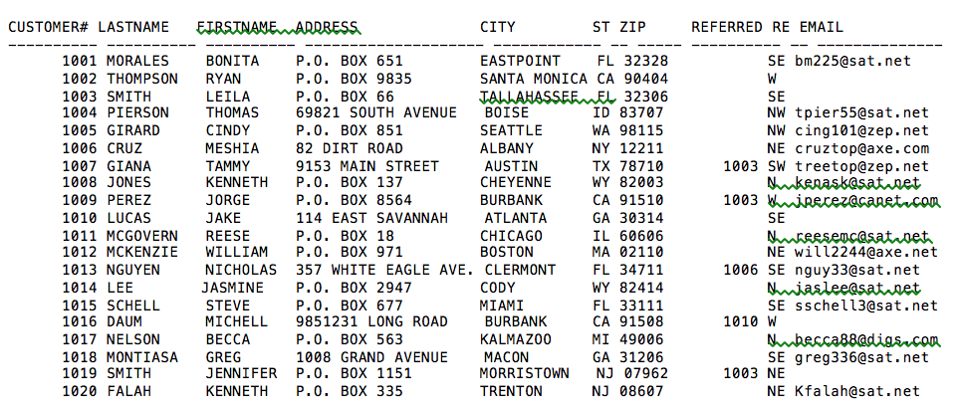
Customer Table Example
Leila Smith (1003) referred three customers
Meshia Cruz (1006) referred one customer
Jake Lucas (1010) referred one customer
©2016. Cengage Learning. All rights reserved.

Slide 25
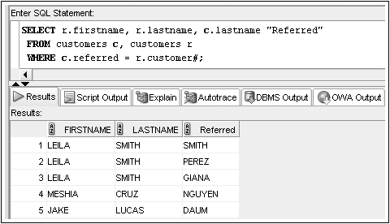
Self-Joins: WHERE Clause Example
©2016. Cengage Learning. All rights reserved.

Slide 26
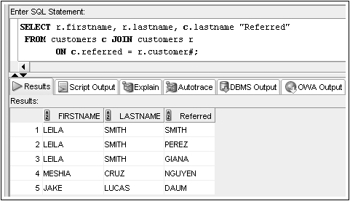
Self-Joins: JOIN…ON Example
©2016. Cengage Learning. All rights reserved.

Slide 27
Outer Joins
Returns all rows from one table
  Called inner table
And matching rows from second table
  Called outer table
Two possible implementations:
  In WHERE clause, include outer join operator (+) immediately after the column name of the table with missing rows to add NULL rows
    inner_table.join_column = outer_table.join_column(+)
  In FROM clause, use FULL, LEFT, or RIGHT with OUTER JOIN keywords
    table1.join_column LEFT OUTER JOIN table2.join_column ON

Slide 28
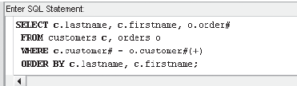
Outer Joins: WHERE Clause Example
©2016. Cengage Learning. All rights reserved.

Slide 29
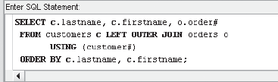
Outer Joins: OUTER JOIN Keyword Example
http://oracle.k2schools.com/oracle-special-operators/
©2016. Cengage Learning. All rights reserved.

Slide 30
Outer Joins (continued)
If multiple join conditions are used, the outer join condition may be required in all of the join conditions to retain nonmatching rows
©2016. Cengage Learning. All rights reserved.

Slide 31
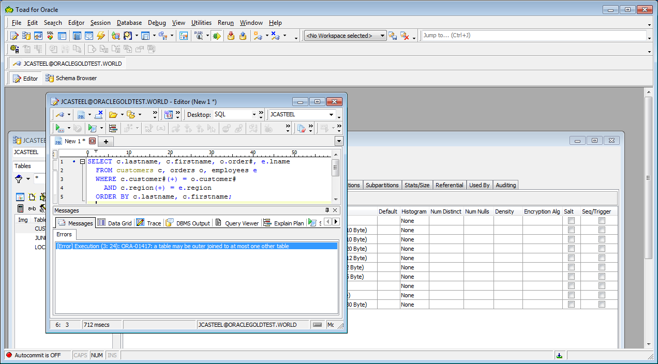
Outer Joins (continued)
In previous versions of Oracle an error would be raised if the outer join operator is used on the same table in more than one join operation
©2016. Cengage Learning. All rights reserved.

Slide 32
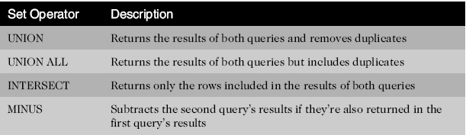
Set Operators
Used to combine the results of two or more SELECT statements
©2016. Cengage Learning. All rights reserved.

Slide 33
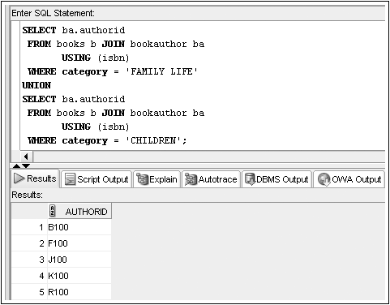
Set Operators: UNION Example
©2016. Cengage Learning. All rights reserved.

Slide 34
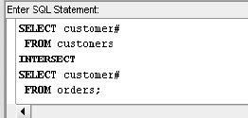
Set Operators: INTERSECT Example
©2016. Cengage Learning. All rights reserved.

Slide 35
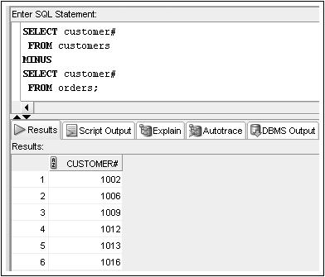
Set Operators: MINUS Example
©2016. Cengage Learning. All rights reserved.

Slide 36
Summary
Data stored in multiple tables regarding a single entity can be linked together through the use of joins
A Cartesian join between two tables returns every possible combination of rows from the tables; the resulting number of rows is always m * n
An equality join is created when the data joining the records from two different tables are an exact match
A non-equality join establishes a relationship based upon anything other than an equal condition
Self-joins are used when a table must be joined to itself to retrieve needed data
©2016. Cengage Learning. All rights reserved.

Slide 37
Summary (continued)
Inner joins are categorized as being equality, non-equality, or self-joins
An outer join is created when records need to be included in the results without having corresponding records in the join tables
  The record is matched with a NULL record so it will be included in the output
Set operators such as UNION, UNION ALL, INTERSECT, and MINUS can be used to combine the results of multiple queries
©2016. Cengage Learning. All rights reserved.

